Slide 1



Data Analysis on Music store Database
“Using SQL”
Present By Venkata Pattabhi

Slide 2
About me
Background
I am Venkata Pattabhi. I have completed my Bachelor of Technology with the specialization of Computer Science and Engineering in the year of 2024 at Aditya Engineering College.
I am learning data science to build a future-ready career by solving real-world problems with data.
LinkedIn : https://www.linkedin.com/in/venkata-pattabhi-ganti/
GitHub : https://github.com/Venkat3690

Slide 3
List of Contents
Objective of the Project
ER Diagram and schema explanation
Key analysis questions (use cases)
SQL query results with screenshots or summaries
Final business insights and recommendations
Conclusion
Q&A Slide

Slide 4

Objective of the Project
The primary objective of this project is to conduct a comprehensive analysis of the music store's sales data to uncover valuable business insights. By leveraging advanced SQL queries, we aim to:
Identify Key Business Metrics: Determine top-performing countries, cities, and customers to understand revenue drivers.
Analyze Customer Behavior: Investigate customer spending habits and identify the most popular music genres and artists.
Provide Actionable Recommendations: Offer data-driven insights to inform strategic decisions, such as identifying the ideal location for a promotional music festival and recognizing top customers for loyalty programs.
Demonstrate SQL Proficiency: Apply complex SQL techniques, including joins, aggregations, and subqueries, to a real-world dataset to extract meaningful information.

Slide 5
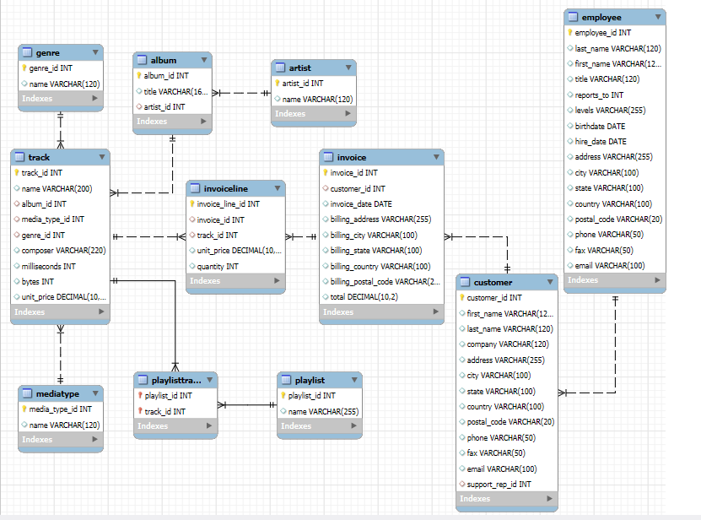

EER Diagram and schema

Slide 6
Schema explanation
The database for the music store is designed using a relational model, which consists of 11 interconnected tables. This structure ensures data integrity and efficiency by organizing information logically and minimizing redundancy.
Database Schema Overview
The schema is divided into three main areas: Sales, Music Library, and Internal Operations.
1. Sales and Customer Data: This core part of the schema revolves around the Invoice table, which links customer purchases to specific music tracks.
The Customer table stores customer information and is linked to the Invoice table.
The Invoice table holds transaction headers, while the Invoiceline table contains the details of each purchase, creating a one-to-many relationship.
2. Music Library: This section catalogs all the music available in the store.
The central table is Track, which contains details about each song.
It is linked to the Album table, which in turn is linked to the Artist table.
Supporting tables like Genre and MediaType provide categorization for each track.
A many-to-many relationship between Playlist and Track is managed through Playlisttrack table.

Slide 7
Schema explanation(continuation..)
3. Internal Operations: The Employee table stores employee data. A key relationship exists between Employee and Customer through the support_rep_id, linking sales support agents to the customers they assist.
Key Relationships
The relationships are established using primary keys (like customer_id or track_id) and foreign keys.
One-to-Many: Most relationships are one-to-many. For example, one Artist can have many Albums, and one Album can have many Tracks. Similarly, one Customer can have many Invoices.
Many-to-Many: A many-to-many relationship exists between playlists and tracks, allowing a track to be on multiple playlists and a playlist to contain multiple tracks. This is enabled by Playlisttrack table.

Slide 8

Key analysis questions (use cases)
This analysis answers critical business questions by querying the music store's database. The key areas of investigation include:
Business & Sales Performance:
What are the top three highest invoice totals?
Which city is the most profitable and the best location for a promotional music festival?
Customer & Artist Insights:
Who is our most valuable customer based on total spending?
Which artists have produced the most rock music tracks?
How much has each customer spent on different artists?
Genre & Track Analysis:
What are the longest tracks in our collection compared to the average?
What is the most purchased music genre in each country?
Who is the top-spending customer for music in each country?

Slide 9
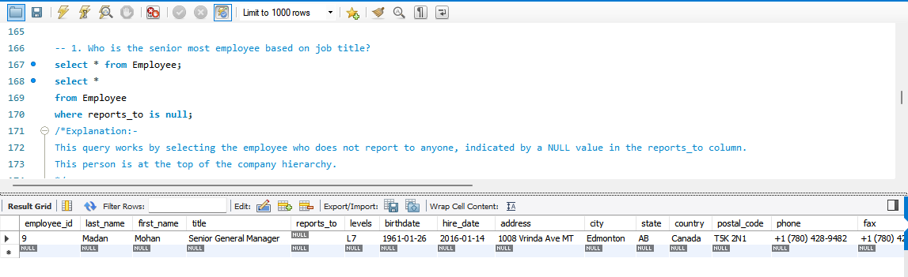

SQL query results with screenshots
Who is the senior most employee based on job title?
Explanation: This query works by selecting the employee who does not report to anyone, indicated by a NULL value in the reports_to column. This person is at the top of the company hierarchy.

Slide 10
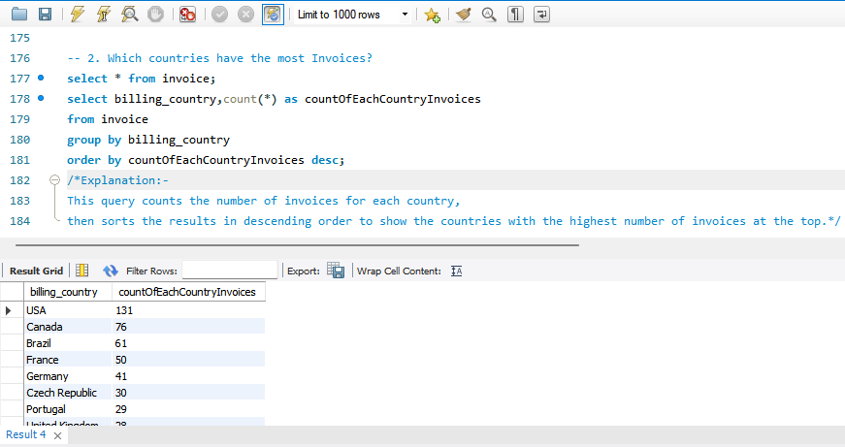

Which countries have the most Invoice?
Explanation: This query counts the number of invoices for each country, then sorts the results in descending order to show the countries with the highest number of invoices at the top.

Slide 11
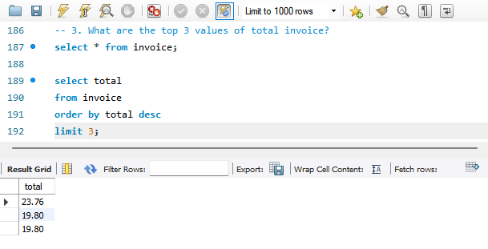
What are the top 3 values of total invoice?
Explanation: This query selects the total column from the invoice table, sorts the values in descending order, and then returns only the top 3 highest values.

Slide 12
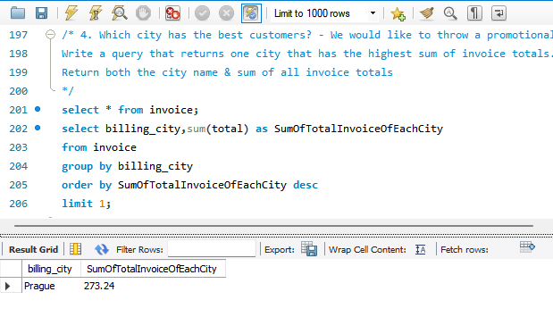
Which city has the best customers? - We would like to throw a promotional Music Festival in the city we made the most money. Write a query that returns one city that has the highest sum of invoice totals. Return both the city name & sum of all invoice totals.
Explanation: This query calculates the total sales for each city, sorts them in descending order, and then returns the city with the highest total.

Slide 13
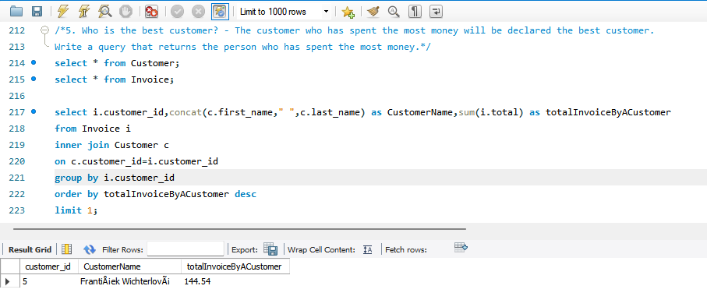
Who is the best customer? - The customer who has spent the most money will be declared the best customer. Write a query that returns the person who has spent the most money.
Explanation: This query joins the Customer and Invoice tables, calculates the total spending for each customer by summing up their invoice totals, and then orders the results in descending order to find the customer with the highest total spending. The LIMIT 1 clause ensures that only the top customer is returned.

Slide 14
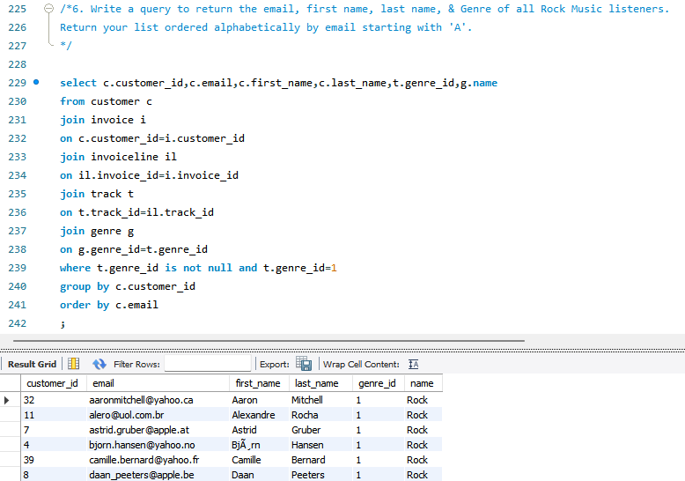

Write a query to return the email, first name, last name, & Genre of all Rock Music listeners. Return your list ordered alphabetically by email starting with 'A'.

Slide 15
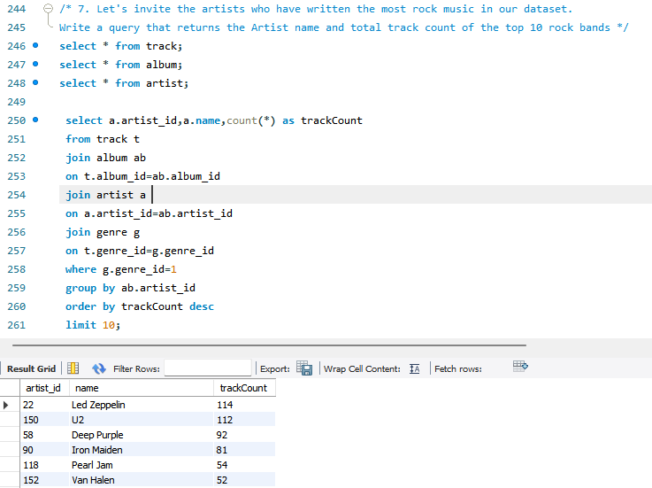
Let's invite the artists who have written the most rock music in our dataset. Write a query that returns the Artist name and total track count of the top 10 rock bands.

Slide 16
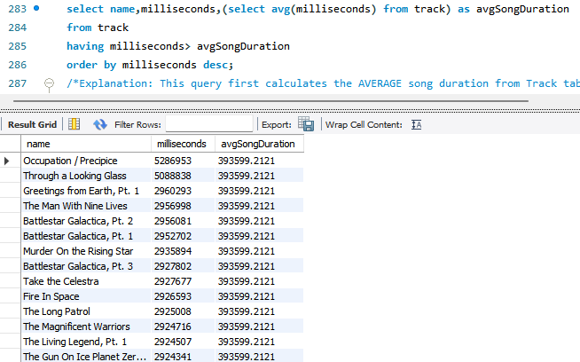
Return all the track names that have a song length longer than the average song length.- Return the Name and Milliseconds for each track. Order by the song length, with the longest songs listed first.

Slide 17
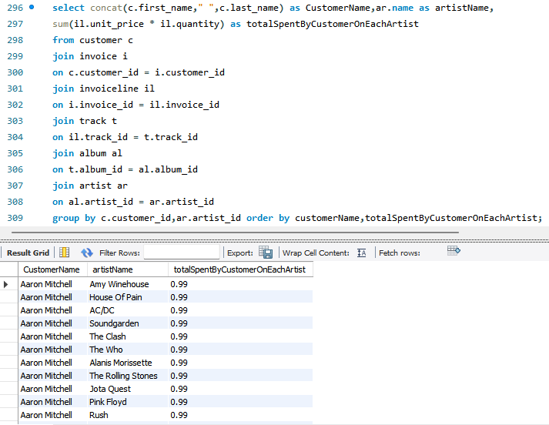
Find how much amount is spent by each customer on artists? Write a query to return customer name, artist name and total spent.

Slide 18
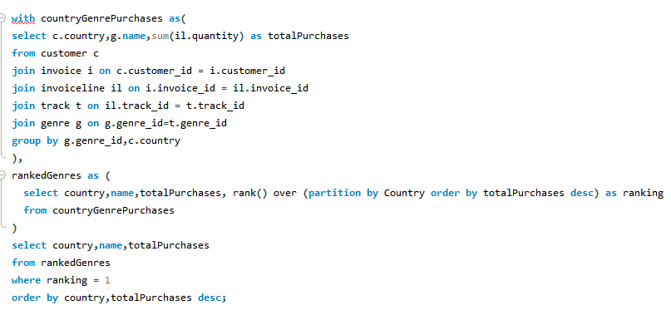
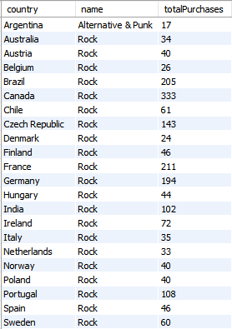
We want to find out the most popular music Genre for each country. We determine the most popular genre as the genre with the highest amount of purchases. Write a query that returns each country along with the top Genre. For countries where the maximum number of purchases is shared, return all Genres.

Slide 19
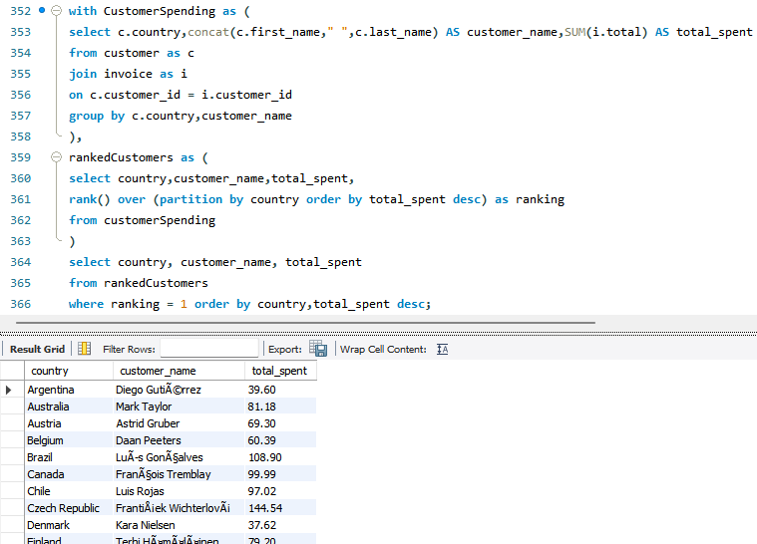
Write a query that determines the customer that has spent the most on music for each country. Write a query that returns the country along with the top customer and how much they spent. For countries where the top amount spent is shared, provide all customers who spent this amount.

Slide 20
Final business insights and recommendations
1. Customer Segmentation and Retention Insight:
We have successfully identified the top-spending customers in each country. These high-value customers are the key drivers of revenue. Recommendation:
Implement a targeted loyalty program or a "VIP" status for these top spenders. Offer them exclusive discounts, early access to new releases, or personalized communications to foster loyalty and encourage repeat purchases.
2. Strategic Marketing and Content Promotion Insight:
We have pinpointed the most popular music genres and artists by country. This data is invaluable for content curation and marketing efforts.
Recommendation:
Prioritize marketing campaigns around these top-selling genres and artists. Feature their albums and tracks prominently on your homepage, in email newsletters, and on social media to capitalize on existing demand.
3. Personalization and Cross-Selling Insight:
Customer spending is often concentrated on specific artists.
Recommendation:
Leverage purchase history to create personalized recommendations. Use this data to suggest new albums from a customer's favorite artists or to cross-sell similar artists, increasing the average order value and improving customer engagement.

Slide 21

Conclusion
Top Customers Drive Revenue:
Our analysis identified the top-spending customers in each country, highlighting a significant concentration of revenue from a select group of high-value individuals. This finding underscores the importance of customer retention and personalized engagement with these key customers.
Genre and Artist Popularity Varies by Region:
We successfully determined the most purchased genres and artists for each country. This regional variation in popularity is a key finding, suggesting that a one-size-fits-all marketing strategy is ineffective. Instead, marketing efforts should be tailored to promote content that aligns with local preferences.
Untapped Potential for Personalization:
By linking customer purchases to specific artists, we found clear patterns in individual spending habits. This provides a strong foundation for implementing hyper-personalized marketing campaigns, such as recommending new music or merchandise from a customer's favorite artists, to increase sales and enhance the customer experience.

Slide 22

Session now: Questions & Discussions

Slide 23
Thank you!
reach me through @venkatapattabhiganti@gmail.com

